Slide 1
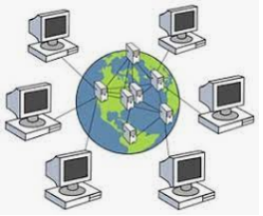
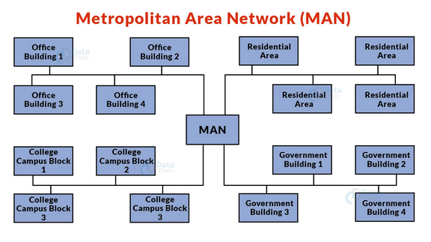
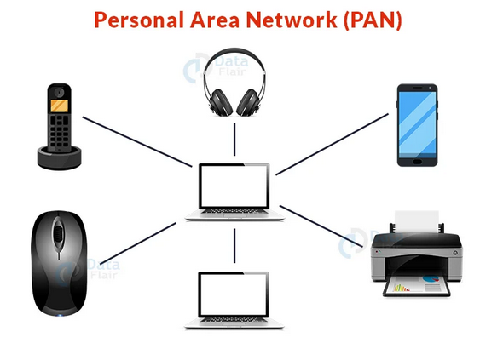
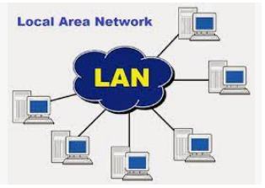
About Networks
Wide Area Network
Peter J Faulks
Peter Faulks About Networks Slide 1

Slide 2


Peter J Faulks
Networks
Local
Area Networks
Personal Area Networks
Networks
Wide Area Networks
Municipal Area Networks
Other Networks
Click the Mouse

Slide 3

About Networks
Help Page
What do networks do
Discuss other Network types
Router and a server computer
main difference between Wired and Wireless networks?
What is a Wireless network?
What is a Mobile network?
advantages of Wireless networks
Security Why are firewalls used?
What is a Wired network
References
Advantages of Local Area Networks
Previous Slide
Disadvantages of Local Area Networks
Next Slide
Back to home page
Peter Faulks About Networks. Slide 3

Slide 4

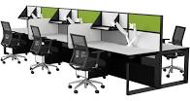
What do networks do
and why do we use them?
A set of digital devices (like smart phones,
computers, tablets or printers) connected together by hard wire or wireless. They are used to
share digital information between devices.
We use them to help in communication, finding information and sharing our work.
Peter Faulks About Networks. Slide 4

Slide 5
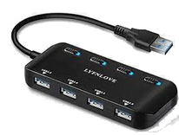
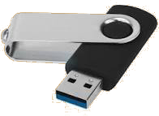
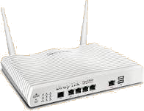
Show a network using a Router and a server computer linking to three more computers
Network hardware
What is a hub?
A hub is the connection point in a computer device where data from many directions converge and are then sent out in many directions to respective devices. A hub may also act as a switch by preventing specific data packets from proceeding to a destination.
https://www.techopedia.com/definition/3167/hub
USB and Hub
Modem with wireless antenna
What is a modem?
Modem is short for Modulator Demodulator. It’s an electronic device used to access the Internet that modulates carrier waves to encode information to be transmitted and also demodulates incoming carrier waves to decode the information they carry. A modem is device that can convert digital data transmitted over WIFI or cables into a form that your computer can use/interpret.
https://www.scienceabc.com/innovation/what-is-a-modem-what-does-it-do-router-working.html
Peter Faulks About Networks. Slide 5

Slide 6
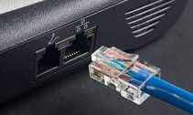
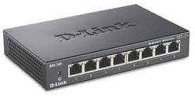
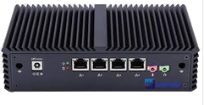
Ethernet Hub and Router
Network hardware
What is a Ethernet hub?
An Ethernet hub, active hub, network hub, repeater hub, multiport repeater, or simply hub is a network hardware device for connecting multiple Ethernet devices together and making them act as a single network segment.
A central switching point that all devices on an Ethernet segment plug into. Also known as a "multiport repeater" and sometimes called a "concentrator, the hub shares the total bandwidth among all users.
https://www.pcmag.com/encyclopedia/term/ethernet-hub
What is a router?
A router is a networking device that forwards data packets between computer networks. Routers perform the traffic directing functions on the Internet. Data sent through the internet, such as a web page or email, is in the form of data packets.
A router is a device that communicates between the internet and the devices in your home
that connect to the internet. As its name implies, it “routes” traffic between the devices and
the internet.
A router is a key part of your home’s internet network. Thanks to it, your laptop, smartphone, smart TV, and other devices can connect to your home Wi-Fi.
https://us.norton.com/internetsecurity-iot-smarter-home-what-is-router.html
Ethernet hub with multiple outlets
Router with Ethernet and other outlets
Peter Faulks About Networks. Slide 6

Slide 7
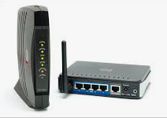
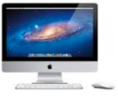
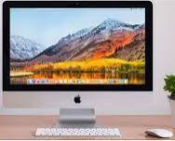
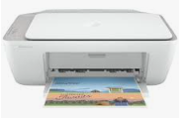
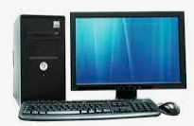



Show a network using a Router and a server computer linking to three more computers
Network hardware
From ISP (NBN)
Router
Modem
Computer 2
Computer 3
Main Server
Computer 1
Peter Faulks About Networks. Slide 7

Slide 8
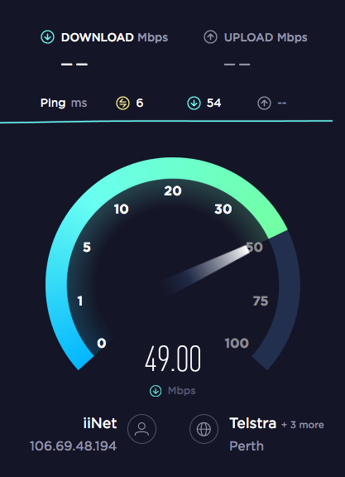
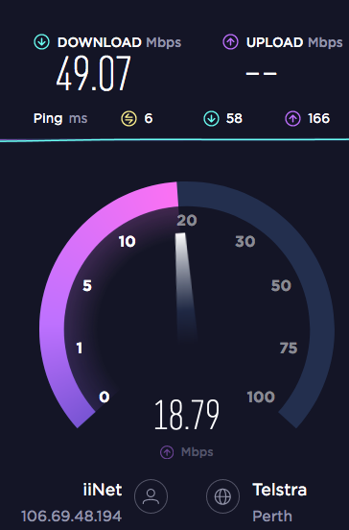
How internet is brought into you home
Any type of computer network that uses wireless data connections for connecting networks but they can be connected to an Internet Service Provider
And the country Network system
An Internet service provider (ISP) sells wi-fi to your home, what
influences cost of this service, (Speed) 50mbs is a reasonable speed
for downloading then we see upload speed (usually less required)
Speed for streaming movies, > 40Mbs (MegaBits per second)
speed for transferring files or images> 20 Mbs
Peter Faulks About Networks. Slide 8

Slide 9
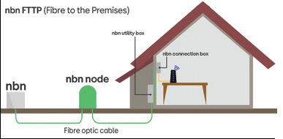
Network protocols into you home
Protocols include:
Transmission Control Protocol (TCP)
Internet Protocol (IP)
User Datagram Protocol (UDP)
Post office Protocol (POP)
Simple mail transport Protocol (SMTP)
File Transfer Protocol (FTP)
Hyper Text Transfer Protocol (HTTP)
Hyper Text Transfer Protocol Secure (HTTPS)
Wi-Fi is connected by (Nodes) two options Phone Line or Mobile
Phone or using fibre optical cable
ISP to Street
To Box or Modem
NBN is National Broadband Network
These packets can then be sent by devices like switches and routers to the designated targets. Ethernet cable, (ADSL) etc.)
Asymmetric Digital subscriber line
Peter Faulks About Networks. Slide 9

Slide 10
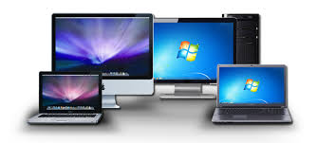
Two advantages of Wireless networks
1. Wireless networks enable multiple devices to use the same internet connection remotely, as well as share files and other resources.
2. They also allow mobile devices, such as laptops, tablets and mobile phones to move around within the network area freely and still maintain a connection to the internet and the network.
Peter Faulks About Networks. Slide 10

Slide 11
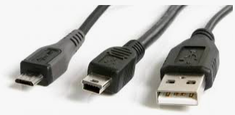
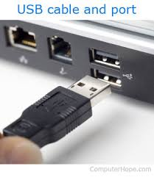
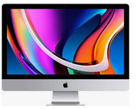


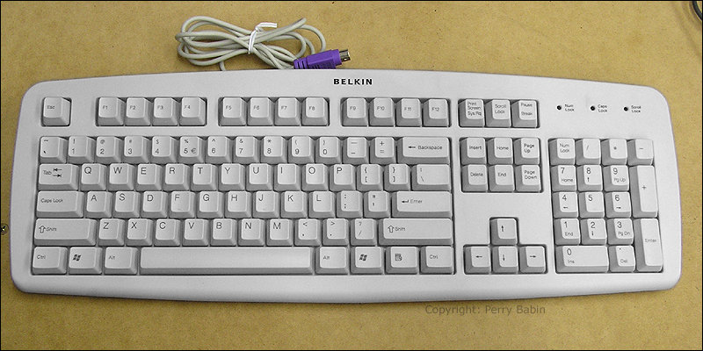
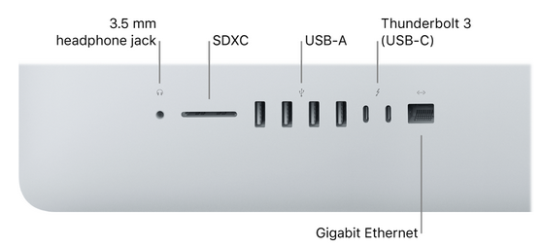



A Wired network?
A Personal Area Network using only cables. (Printer, USB cables, phone cable, )
Connected to a wire or system of wires, as an electronic device connecting computer systems or peripheral devices
Wired modem
Keyboard
USB Flash drive
plug in to Hub
Mouse
Printer
Wired Printer
Peter Faulks About Networks. Slide 11

Slide 12
Advantages of Local Area Networks Detailed explanation
Share data and information
Sharing of resources such as hard disk drives, DVD drives and Printers
Communication
exchange messages and data in a convenient way. Since the data is placed on the server it can be accessed anytime by the LAN users.
Share hardware
Share software A single computer with the licensed software can be shared among other users in the network.
Transferring money
Peter Faulks About Networks. Slide 12

Slide 13

Disadvantages of Local Area Networks
Virus and malware Appearance of virus in a LAN based infrastructure is highly dangerous. If one the attached computers are affected with a virus, it can easily spread to the remaining computers present on the network. Since it is rather easy to gain access to programs and other types of data, security concerns are a big issue in LAN. The sole responsibility to stop unauthorized access is in the hands of LAN administrators.
Vulnerabilities –
Since all the data of the connected computers are stored inside a central server, unauthorized users can view all the browsing history and downloads of all the connected computers
Complexity - the initial cost involved in setting up the network is quite high. This is mainly due to the requirement of a special software that is needed to make a server. In addition to that purchasing of hardware equipment's such as routers, hubs, switches and cables are required for the first time setup.
https://www.hitechwhizz.com/2020/07/7-advantages-and-disadvantages-drawbacks-benefits-of-lan.html
Peter Faulks About Networks. Slide 13

Slide 14
Discuss other Network types
PAN – Personal Area Networks which is a convenient 1 person network, wired printers modem, speakers
LAN – Local Area Network which are a few computers linked to 1 or 2 printers with a shared internet connection,
WAN – Wide Area Network which are networks that cover any geographical area.
MAN - Metropolitan Area Networks which are networks that cover a town or city and lastly the world
Peter Faulks About Networks. Slide 14

Slide 15
What is the main difference between Wired and Wireless networks?
A wireless network allows devices to stay connected to the network but roam untethered to any wires.
A wired network uses cables to connect devices, such as laptop or desktop computers, to the Internet or another network.
Peter Faulks About Networks. Slide 15

Slide 16
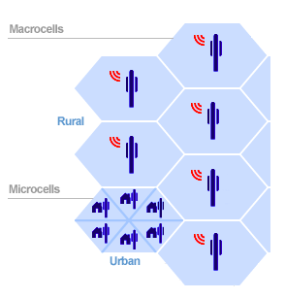
What is a Mobile network?
A system of connecting movable computer systems or peripheral devices, each one remote from the others.
A mobile phone network or cellular phone network as it is also known, is made up of a large number of signal areas called cells. These cells join or overlap each other to form a large coverage area. Users on the network can cross into different cells without loosing connection.
Within each cell you will find a base station or mobile phone tower, which sends and receives the mobile transmissions. A mobile device will connect to the nearest or least congested base station. The base stations are connected to a digital exchange where the communication is sent to other telephone or data networks.
Cells will often be smaller in size throughout large towns and cities due to the number of users in the area. The higher the population density the more base stations are needed.
https://mobilenetworkguide.com.au/mobile_phone_networks.html
Peter Faulks About Networks. Slide 16

Slide 17
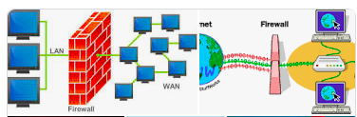
Security Why are firewalls used?
A firewall is a network security system designed to prevent unauthorized access to or from a private network. ... Network firewalls are frequently used to prevent unauthorized Internet users from accessing private networks connected to the Internet, especially intranets.
Peter Faulks About Networks. Slide 17

Slide 18
About Networks Portfolio
References
Hub: https://www.techopedia.com/definition/3167/hub
Modem: https://www.scienceabc.com/innovation/what-is-a-modem-what-does-it-do-router-working.html
https://us.norton.com/internetsecurity-iot-smarter-home-what-is-router.html
https://www.pcmag.com/encyclopedia/term/ethernet-hub
Peter Faulks About Networks. Slide 18

